Slide 1


Slide 2
Welcome

Slide 3
Internet Of Things

Slide 4
What is IOT?

Slide 5
What is internet?

Slide 7
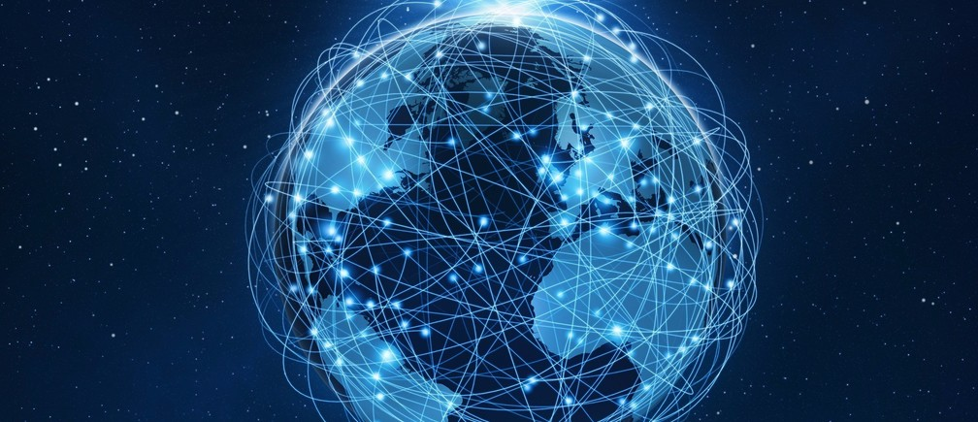

Slide 8
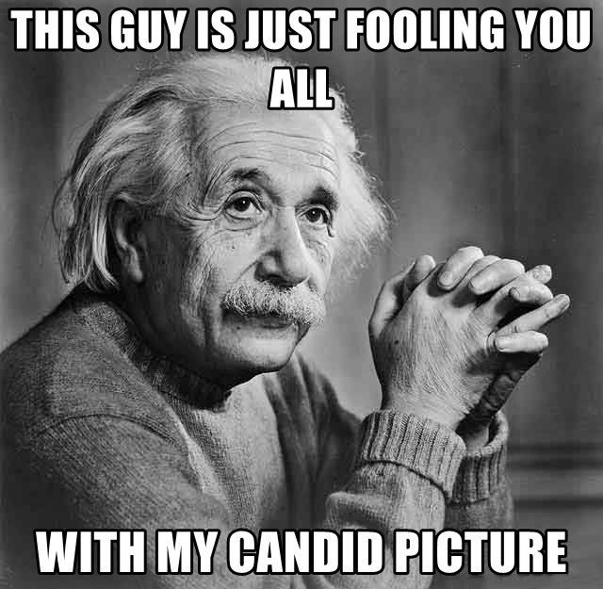

Slide 9
Internet :
A global computer network providing
a variety of information and communication facilities,
consisting of interconnected networks using
standardized communication protocols
- Of things

Slide 11
What is ‘Things’ in IOT?
- Devices, appliances, vehicles and other entities containing processors, software, sensors along with their functionality and an ability to exchange data.

Slide 12
What is IOT?
- An entourage of connected smart devices.

Slide 13
Why IOT?
Case study
Nest thermostat.

Slide 14
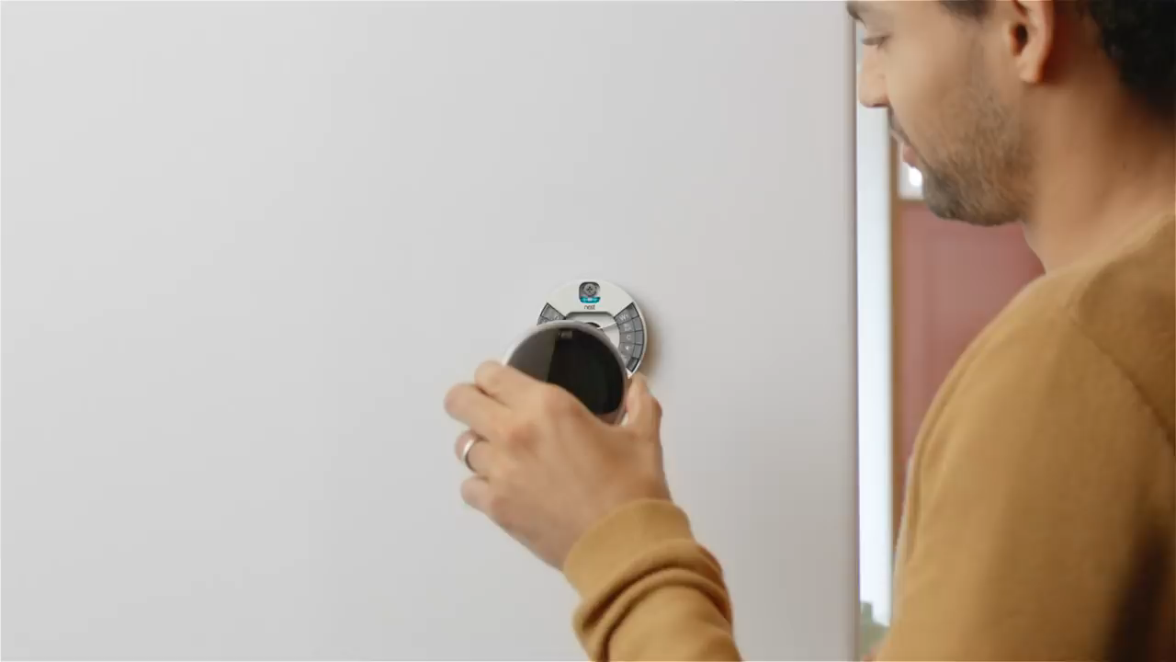
Why IOT?
Case study
Nest thermostat.

Slide 15
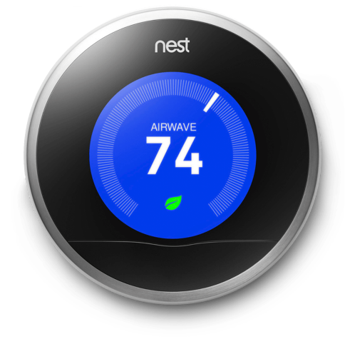
Nest:
It controls temperature.
It learns your usage patterns.
It adjusts the temperature accordingly.
Auto On/Off depending on your presence.
Monitor power consumption data.
Remote control.

Slide 16
Other devices:
Lights.
Appliances.
vehicles.
Security devices.
Energy management system.
Resource management system.
etc.

Slide 17
Constituency of IOT:
Platform/software
Hardware

Slide 18
IOT Platform:
Software framework which consist of the following properties
Cloud platform.
Thin client.
Scalability.
Interoperability.
Security.

Slide 19
Emerging IOT Platform:
Microsoft Windows Azure IOT
AWS IOT platform
Google cloud
IBM Watson IOT

Slide 20
Hardware:
Cost effective
Reliable
Secure
Development - Rapid prototyping.

Slide 21

Raspberry PI

Slide 22
What is Raspberry PI?
It is a micro – computer which run an operating system and allows
users to perform a wide gamut of computation and operation.

Slide 23
Advantage of using Raspberry PI
Multi programming language support.
You can easily connect to the internet.
It can run windows.

Slide 25
Windows 10 IOT core

Slide 26
What is Windows 10 IOT core?

Slide 27
Advantages of Windows 10 IOT core

Slide 28
Demo

